Slide 1
CS2006 Operating Systems
SPRING 2023
National University of Computer and Emerging Sciences

Slide 2
Chapter 6
Synchronization Tools

Slide 3
In this chapter, we discuss various mechanisms to ensure the orderly execution of cooperating processes that share a logical address space, so that data consistency is maintained.

Slide 4
Multiple Processes
Operating Systems is managing multiple processes:
Multiprogramming- The management of multiple processes within a uniprocessor system.
Multiprocessing- The management of multiple processes within a multiprocessor.
Distributed Processing- The management of multiple processes executing on multiple, distributed computer systems .e.g. clusters
Big Issue is Concurrency
Notes:
The central themes of operating system design are all concerned with the management of processes and threads:
• Multiprogramming:
The management of multiple processes within a uniprocessor system.
• Multiprocessing:
The management of multiple processes within a multiprocessor.
• Distributed processing:
The management of multiple processes executing on multiple, distributed computer systems.
E. G clusters
Concurrency encompasses a host of design issues, including
communication among processes,
sharing of and competing for resources (such as memory, files, and I/O access),
synchronization of the activities of multiple processes, and
allocation of processor time to processes.

Slide 5
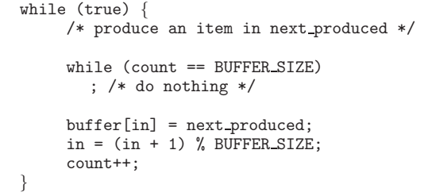
A modified PRODUCER()

Slide 6
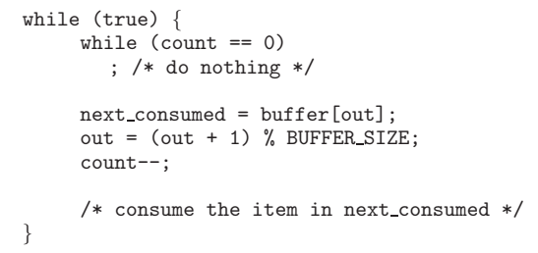
A modified PRODUCER()
Modified CONSUMER()

Slide 7



Slide 8
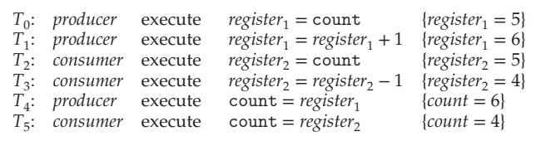

Slide 9
Race Condition
The producer and consumer routines shown above are correct separately, they may not function correctly when executed concurrently.
We would arrive at this incorrect state because we allowed both processes to manipulate the variable count concurrently.
A situation like this, where several processes access and manipulate the same data concurrently and the outcome of the execution depends on the particular order in which the access takes place, is called a race condition

Slide 10
The prominence of multicore systems has brought an increased emphasis on developing multithreaded applications.
In such applications, several threads—which are quite possibly sharing data—are running in parallel on different processing cores.
Clearly, we want any changes that result from such activities not to interfere with one another.

Slide 11
Example for Race condition
Suppose a customer wants to book a seat on UAL 56. Ticket agent will check the #-of-seats. If it is greater than 0, he will grab a seat and decrement #-of-seats by 1.
UAL 56: #-of-seats=12
Main memory
…
Terminal
Terminal
Terminal
Ticket Agent 1
Ticket Agent 2
Ticket Agent n

Slide 12
Example for Race condition(cont.)
Ticket Agent 1
P1: LOAD #-of-seats
P2: DEC 1
P3: STORE #-of-seats
Ticket Agent 2
Q1: LOAD #-of-seats
Q2: DEC 1
Q3: STORE #-of-seats
Ticket Agent 3
R1: LOAD #-of-seats
R2: DEC 1
R3: STORE #-of-seats
Suppose instructions are interleaved as P1,Q1,R1,P2,Q2,R2,P3,Q3,R3
To solve the above problem, we must make sure that:
P1,P2,P3 must be completely executed before we execute Q1 or R1, or
Q1,Q2,Q3 must be completely executed before we execute P1 or R1, or
R1,R2,R3 must be completely executed before we execute P1 or Q1.

Slide 13
The Critical-Section Problem
Consider a system consisting of n processes {P0, P1, ..., Pn-1}. Each process has a segment of code, called a critical section, in which the process may be accessing — and updating — data that is shared with at least one other process
when one process is executing in its critical section, no other process is allowed to execute in its critical section.
The critical-section problem is to design a protocol that the processes can use to synchronize their activity so as to cooperatively share data
Notes:
Consider as an example a kernel data structure that maintains a list of all open files in the system. This list must be modified when a new file is opened or closed (adding the file to the list or removing it from the list). If two processes were to open files simultaneously, the separate updates to this list could result in a race condition

Slide 14
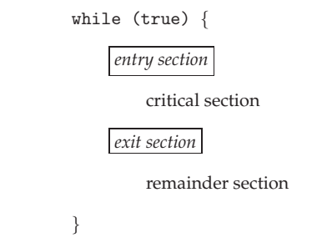
The Critical-Section Problem
The section of code implementing this request is the entry section.
The critical section may be followed by an exit section.
The remaining code is the remainder section

Slide 15
Solution to the critical-section problem
Mutual exclusion. If process Pi is executing in its critical section, then no other processes can be executing in their critical sections.
Progress. If no process is executing in its critical section and some processes wish to enter their critical sections, then only those processes that are not executing in their remainder sections can participate in deciding which will enter its critical section next
Bounded waiting. There exists a bound, or limit, on the number of times that other processes are allowed to enter their critical sections

Slide 16
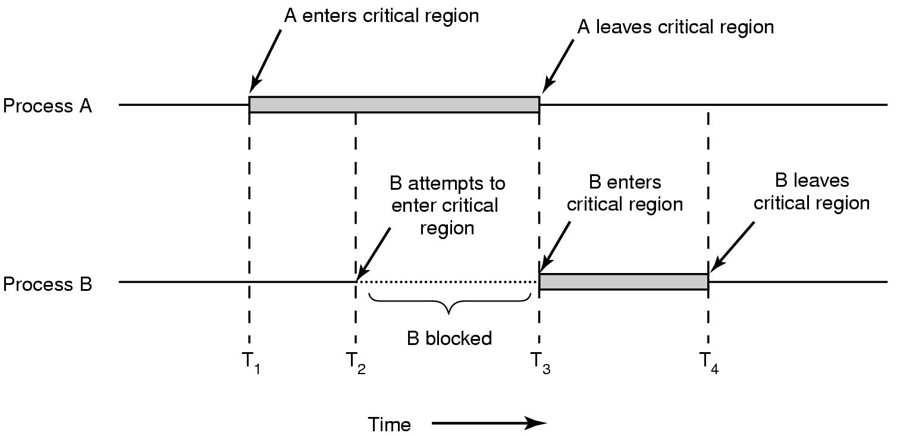

Slide 17
No two processes may be simultaneously inside their critical regions.
No assumptions may be made about speeds or the number of CPUs.
No process running outside its critical region may block other processes.
No process should have to wait forever to enter its critical region.

Slide 18
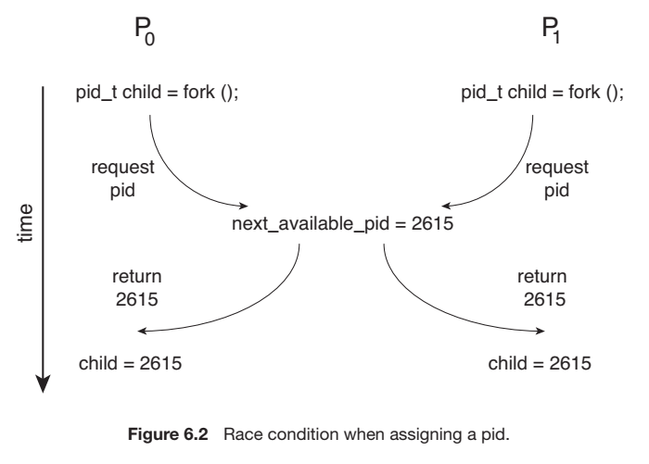
Notes:
Other kernel data structures that are prone to possible race conditions include structures for maintaining memory allocation, for maintaining process lists, and for interrupt handling.

Slide 19
Two general approaches are used to handle critical sections in operating systems: preemptive kernels and non-preemptive kernels.
A preemptive kernel allows a process to be preempted while it is running in kernel mode.
A non-preemptive kernel does not allow a process running in kernel mode to be preempted; a kernel-mode process will run until it exits kernel mode, blocks, or voluntarily yields control of the CPU.
free from race conditions on kernel data structures

Slide 20
Peterson’s Solution
Solution to the critical-section problem.
it provides a good algorithmic description of solving the critical-section problem
Peterson’s solution is restricted to two processes that alternate execution between their critical sections and remainder sections.
Peterson’s solution requires the two processes to share two data items:
int turn; boolean flag[2];

Slide 21
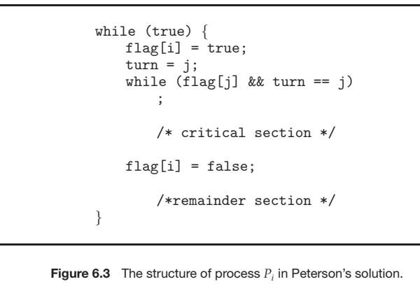

Slide 22
Peterson’s Solution
turn indicates whose turn it is to enter its critical section.
That is, if turn == i, then process Pi is allowed to execute in its critical section
The flag array is used to indicate if a process is ready to enter its critical section
For example, if flag[i] is true, Pi is ready to enter its critical section
To enter the critical section, process Pi first sets flag[i] to be true and then sets turn to the value j, thereby asserting that if the other process wishes to enter the critical section, it can do so.

Slide 23
If both processes try to enter at the same time, turn will be the decider

Slide 24
Peterson’s Solution
Provable the three CS requirements are met:
Mutual Exclusion is preserved:
Pi enters CS only if either flag[j] == false or turn== i
turn can be either 0 or 1 but cannot be both
Progress Requirement is satisfied
Bounded-Waiting is met
Once Pj exits its critical section, it will reset flag[j] to false, allowing Pi to enter its critical section.
If Pj resets flag[j] to true, it must also set turn to i
In Peterson's algorithm, a process will never wait longer than one turn for entrance to the critical section.

Slide 25
Hardware Support for Synchronization
software-based solutions are not guaranteed to work on modern computer architecture
Many modern computer systems provide special hardware instructions that allow us either to test and modify the content of a word or to swap the contents of two words atomically.
Atomic: one uninterruptible unit

Slide 26
Atomic Variables
We know that incrementing or decrementing an integer value may produce a race condition.
Atomic variables can be used in to ensure mutual exclusion in situations where there may be a data race on a single variable while it is being updated

Slide 27
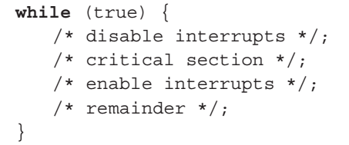
Interrupt Disabling
To guarantee mutual exclusion, it is sufficient to prevent a process from being interrupted.
disabling interrupts guarantees mutual exclusion.
Because the critical section cannot be interrupted, mutual exclusion is guaranteed.

Slide 28
Mutex Locks
Mutex: mutual exclusion
We use the mutex lock to protect critical sections and thus prevent race conditions.
A process must acquire the lock before entering a critical section; it releases the lock when it exits the critical section.
The acquire() function acquires the lock, and the release() function releases the lock
A mutex lock has a boolean variable available whose value indicates if the lock is available or not
If the lock is available, a call to acquire() succeeds, and the lock is then considered unavailable
A process that attempts to acquire an unavailable lock is blocked until the lock is released

Slide 29
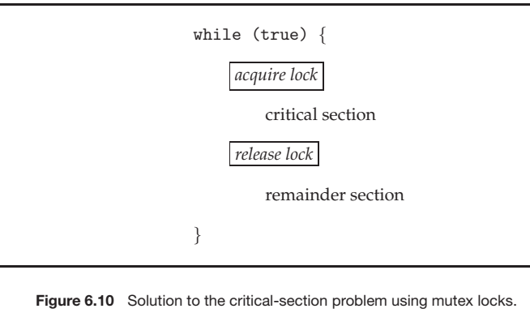

Slide 30
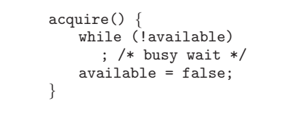

Calls to either acquire() or release() must be performed atomically

Slide 31
Disadvantage: busy waiting.
While a process is in its critical section, any other process that tries to enter is critical section must loop continuously in the call to acquire().
The type of mutex lock we have been describing is also called a spinlock because the process “spins” while waiting for the lock to become available

Slide 32
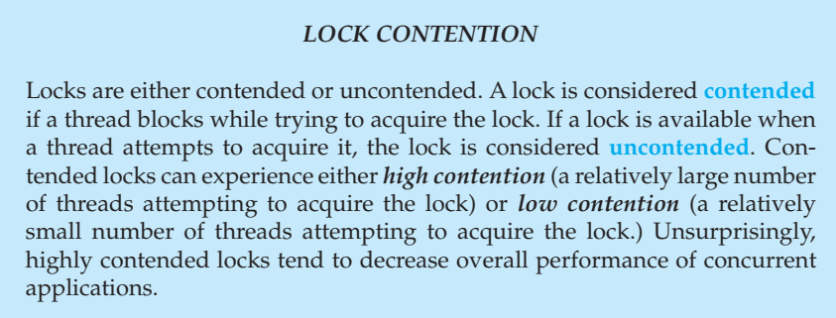

Slide 33
Pthreads Synchronization – Mutex Lock
The mutex is acquired and released with the pthread_mutex_lock() and pthread_mutex_unlock() functions.
If the mutex lock is unavailable when pthread_mutex_lock() is invoked, the calling thread is blocked until the owner invokes pthread_mutex_ unlock().

Slide 34
Semaphores
Mutex locks are generally considered the simplest of synchronization tools.
a semaphore is a variable or abstract data type used to control access to a common resource by multiple processes in a concurrent system
A semaphore S is an integer variable that, apart from initialization, is accessed only through two standard atomic operations: wait() and signal()

Slide 35
Semaphores: Fundamental Principle
Two or more processes can cooperate by means of simple signals, such that a process can be forced to stop at a specified place until it has received a specific signal.
For signaling, semaphores are used.
To transmit a signal via semaphore s, a process executes the primitive Signal (s)
To receive a signal via semaphore s, a process executes the primitive Wait(s) ;
If the corresponding signal has not yet been transmitted, the process is suspended until the transmission takes place.

Slide 36
We can view the semaphore as a variable that has an integer value upon which only three operations are defined:
A semaphore may be initialized to a nonnegative integer value.
The Wait() operation decrements the semaphore value. If the value becomes negative, then the process executing the Wait is blocked. Otherwise, the process continues execution.
The Signal() operation increments the semaphore value. If the resulting value is less than or equal to zero, then a process blocked by a semWait operation, if any, is unblocked.

Slide 37
Since Semaphores are integer variables, their value acts as a signal, which allows or does not allow a process to access the critical section of code or certain other resources.

Slide 38
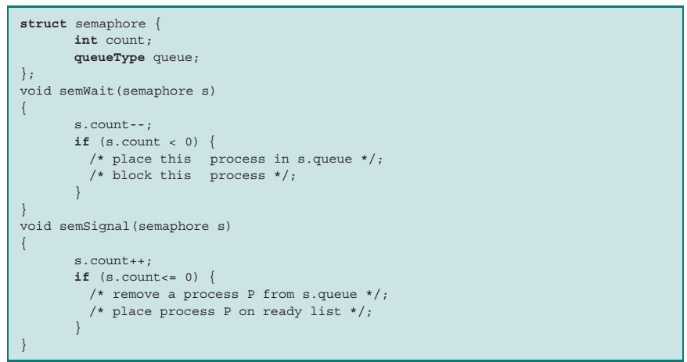
Notes:
Each semaphore has an integer value and a list of processes list. When a process must wait on a semaphore, it is added to the list of processes

Slide 39
To begin, the semaphore has a zero or positive value.
If the value is positive, that value equals the number of processes that can issue a wait and immediately continue to execute.
If the value is zero the next process to issue a wait is blocked, and the semaphore value goes negative
Each subsequent wait drives the semaphore value further into minus territory. The negative value equals the number of processes waiting to be unblocked.

Slide 40
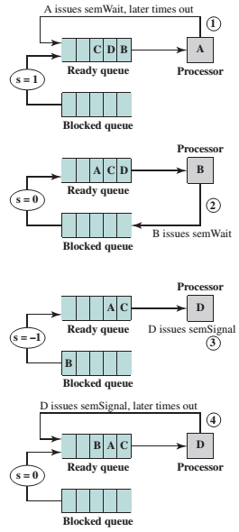
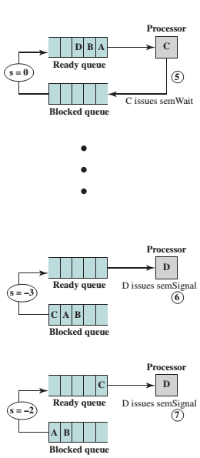

Slide 41
Mutual Exclusion
The semaphore is initialized to 1.
Thus, the first process that executes a Wait will be able to enter the critical section immediately, setting the value of s to 0.
Any other process attempting to enter the critical section will find it busy and will be blocked, setting the value of s to −1.
Any number of processes may attempt entry; each such unsuccessful attempt results in a further decrement of the value of s.
When the process that initially entered its critical section departs, s is incremented and one of the blocked processes (if any) is removed from the queue of blocked processes associated with the semaphore and put in a Ready state.

Slide 42
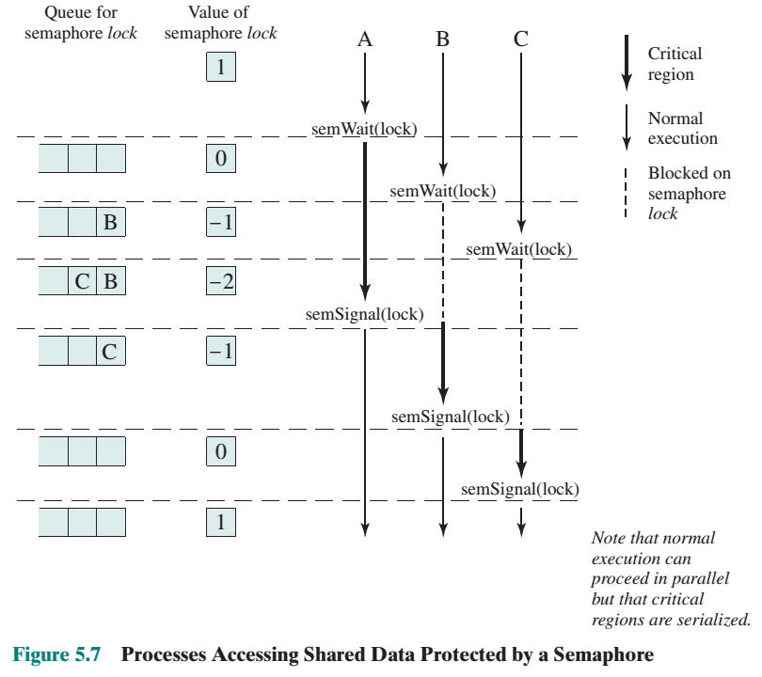

Slide 43
Semaphore Implementation
Recall that the implementation of mutex locks suffers from busy waiting.
The definitions of the wait() and signal() semaphore operations just described present the same problem.
To overcome this problem, we can modify the definition of the wait() and signal() operations as follows:
When a process executes the wait() operation and finds that the semaphore value is not positive, it must wait. However, rather than engaging in busy waiting, the process can suspend itself
A process that is suspended, waiting on a semaphore S, should be restarted when some other process executes a signal() operation.

Slide 44
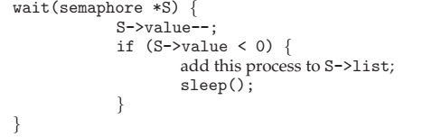
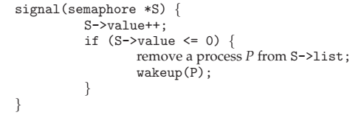

Slide 45
The sleep() operation suspends the process that invokes it. The wakeup(P) operation resumes the execution of a suspended process P

Slide 46
Binary Semaphores
A more restricted version, known as the binary semaphore, may only take on the values 0 and 1 and can be defined by the following three operations:
A binary semaphore may be initialized to 0 or 1.
The semWaitB (Wait) operation checks the semaphore value. If the value is zero, then the process executing the semWaitB is blocked. If the value is one, then the value is changed to zero and the process continues execution.
The semSignalB (Signal) operation checks to see if any processes are blocked on this semaphore (semaphore value equals 0). If so, then a process blocked by a semWaitB operation is unblocked. If no processes are blocked, then the value of the semaphore is set to one.

Slide 47
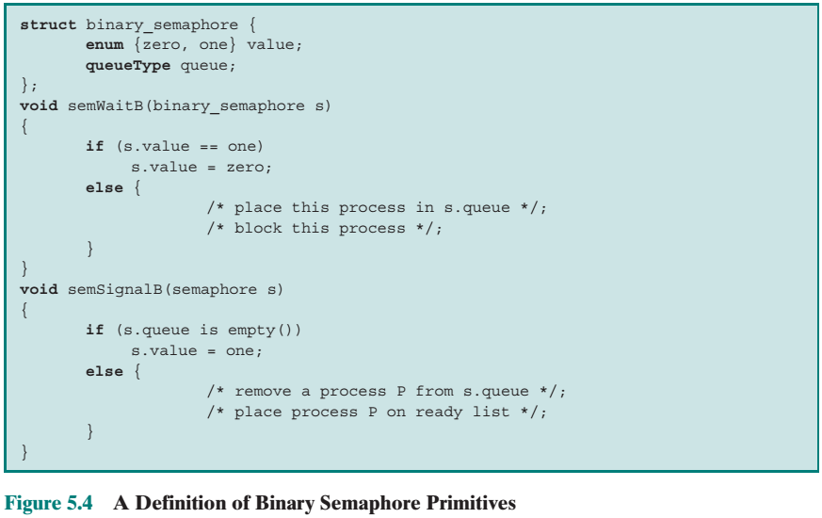

Slide 48
For both counting semaphores and binary semaphores, a queue is used to hold processes waiting on the semaphore.
Which processes are removed from such a queue?
The fairest removal policy is first-in-first-out (FIFO): a semaphore whose definition includes this policy is called a strong semaphore.
A semaphore that does not specify the order in which processes are removed from the queue is a weak semaphore.
Strong semaphores guarantee freedom from starvation, while weak semaphores do not

Slide 49
MUTEX VS Binary Semaphores???

Slide 50
POSIX - Semaphores
#include <semaphore.h>
Sem_t sem;
/* Create the semaphore and initialize it to 1 */
Sem_init(&sem, 0, 1);
The sem_init() function is passed three parameters:
A pointer to the semaphore
A flag indicating the level of sharing
The semaphore’s initial value

Slide 51
POSIX - Semaphores
/* acquire the semaphore */
Sem_wait(&sem);
/* critical section */
/* release the semaphore */
Sem_post(&sem);

Slide 52
Recommended
https://www.gatevidyalay.com/semaphore-in-os-practice-problems/

Slide 53
Liveness: Deadlock
Liveness refers to a set of properties that a system must satisfy to ensure that processes make progress during their execution life cycle.
DeadLock: a situation where a set of blocked processes where each holding a resource and waiting to acquire a resource held the other process

Slide 54
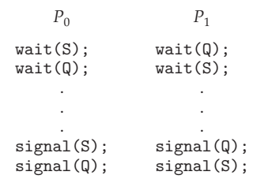

Slide 55
Starvation
Starvation is the name given to the indefinite postponement of a process because it requires some resource before it can run, but the resource, though available for allocation, is never allocated to this process.

Slide 56
Deadlock Vs. Starvation
Deadlock refers to the situation when processes are stuck in circular waiting for the resources.
On the other hand, starvation occurs when a process waits for a resource indefinitely.

Slide 57
Priority Inversion
Priority Inversion – Scheduling problem when lower-priority process holds a lock needed by higher-priority process
Solved via priority-inheritance protocol

Slide 58
Priority Inheritance Protocol
when a job blocks one or more high-priority jobs, it ignores its original priority assignment and executes its critical section at an elevated priority level.
After executing its critical section and releasing its locks, the process returns to its original priority level

Slide 59
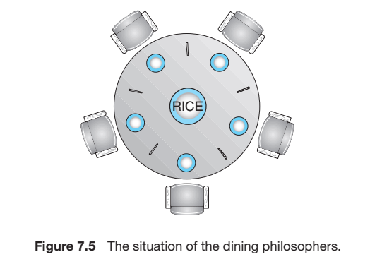
The Dining-Philosophers Problem

Slide 60
The dining-philosophers problem is considered a classic synchronization problem because it is an example of a large class of concurrency-control problems.
It is a simple representation of the need to allocate several resources among several processes in a deadlock-free and starvation-free manner

Slide 61
Task: Semaphore Solution to the following
Producer-Consumer Problem
Reader-Writer Problem
Dining-Philosophers Problem

